Slide 1
Agenda
Elasticbeanstalk Overview
Major Feature with Elasticbeanstalk.
Configuration overview
Cost
QA.

Slide 2
Elastic Bean Stalk Overview
AWS Elastic Beanstalk is an easy-to-use service for deploying and scaling web applications and services developed with Java, .NET, PHP, Node.js, Python, Ruby, Go, and Docker on familiar servers such as Apache, Nginx, Passenger, and IIS.
We can simply upload your code and Elastic Beanstalk automatically handles the deployment, from capacity provisioning, load balancing, auto-scaling to application health monitoring. At the same time, you retain full control over the AWS resources powering your application and can access the underlying resources at any time.

Slide 3
Major Feature with Elasticbeanstalk
Fast and simple to begin
Developer productivity
Impossible to outgrow
Complete resource control
Demo

Slide 4
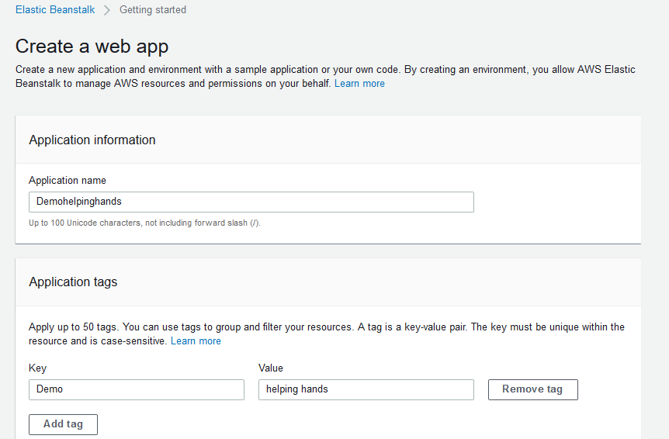
Configuration overview

Slide 5
Configuration overview

Slide 6
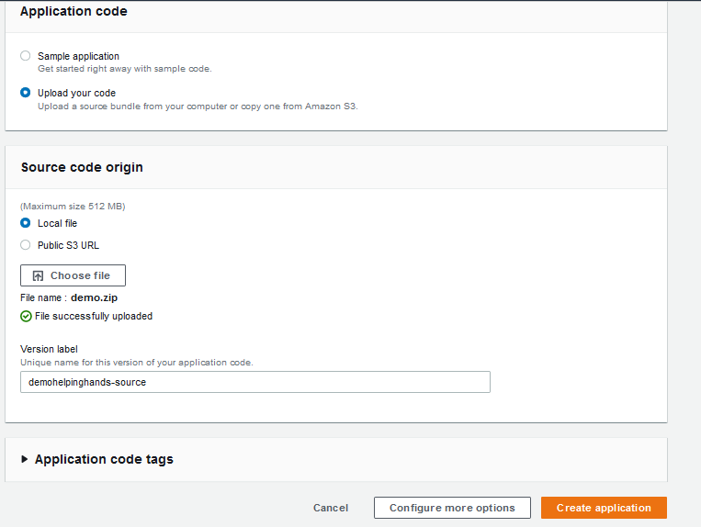
Configuration overview

Slide 7
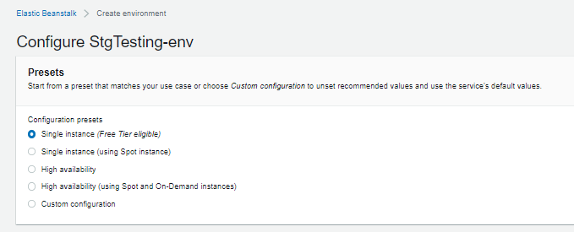
Configuration overview

Slide 8
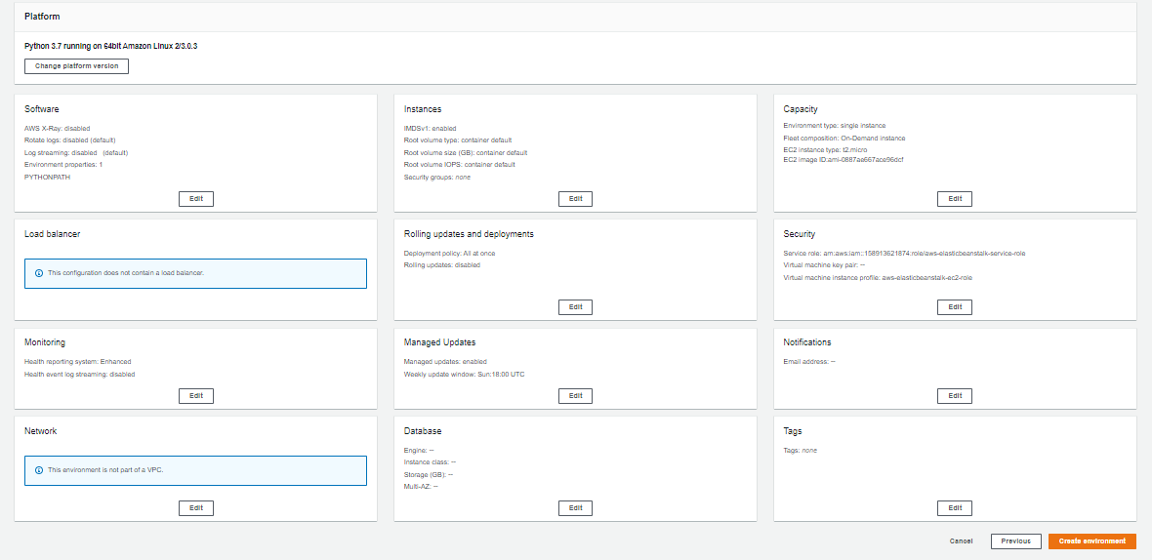
Configuration overview

Slide 9
Configuration overview

Slide 10
Cost
There is no additional charge for Elastic Beanstalk - you pay only for the AWS resources needed to store and run your applications.

Slide 11
Thank you!

